Slide 1

Regression solutions in Real Estate
Project developed by:
Leonor Drummond
Jose Roldan
Patrick Brunswyck
Hoang Minh Nguyen

Slide 2

Project Goals
Insight from 10000 properties
Defining a good regression model
Predicting house prices
Notes:
Sort of an introduction, to then show the content.
“This project comes from this client…. With the aim to….. In sequence of…..”

Slide 3
Table Content
Data cleaning
Data preprocessing
Defining the best regression type
What we could achieve
Recommendations
Conclusion

Slide 4
Data Cleaning
Used the previous pre-cleaned data set;
Focus on adapting data set for machine leaning;
Keeping the house features that are better for perditions;
Removing the ones that don’t fit good this purpose;
Notes:
- Why is data cleaning important?
-Used the previous pre-cleaned data set: where this data comes from; how it was cleaned and how good??
-Focus on adapting data set for machine leaning: no categorical; highly correlated data ----→ discussed in the next slide with correlation map
- Keeping the house features that are better for perditions: ----→ discussed in the next slide with correlation map
- Removing the ones that don’t fit good this purpose: outliers

Slide 5
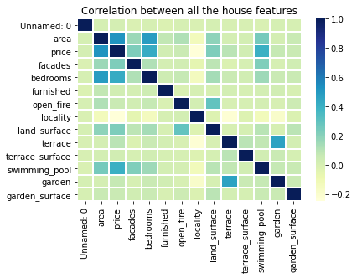
Data Cleaning
frequency
Notes:
What features are highly correlated;
Why not including swimming pool;

Slide 6
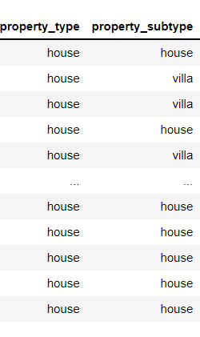
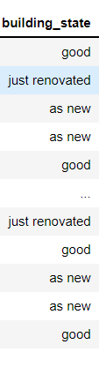
Data preprocessing
Removing redundancy such as subtype property;
Data engineering;
Standardization;
One Hot encoding is depreciated in
linear regression.
Notes:
Why is data pre processing important?
Why remove redundancy
What king of data engineering we did and why
Why standardize the data
Why not hot enconding other feature?

Slide 7
GRAPHIC WITH RELATION BETWEEN STATE OF BUILDING???
Huang Mihn graph

Slide 8
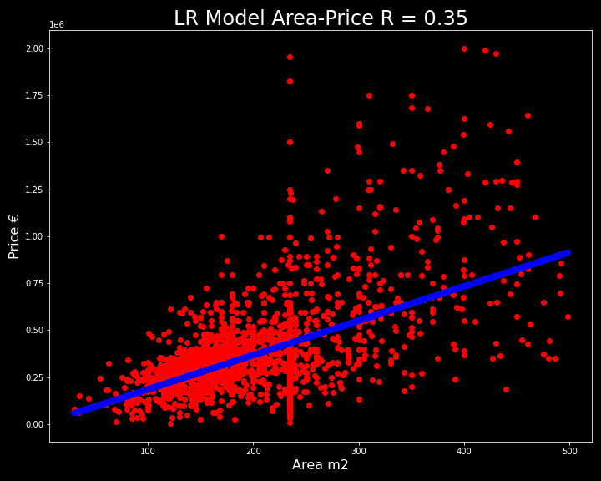
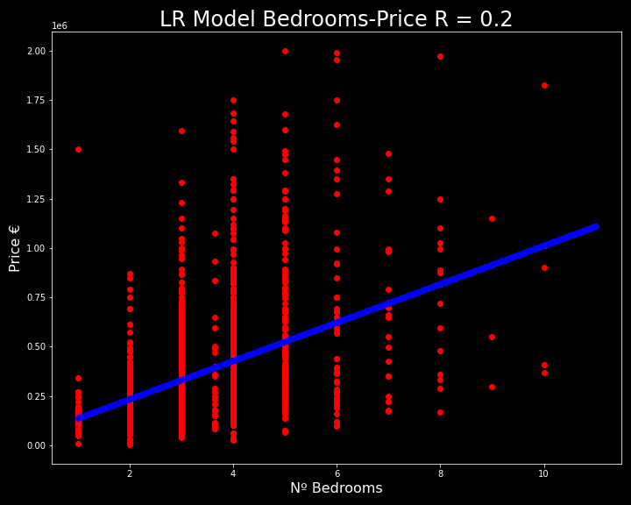
Defining the best regression type
Linear Regression between price and area
Linear Regression between price and bedrooms

Slide 9
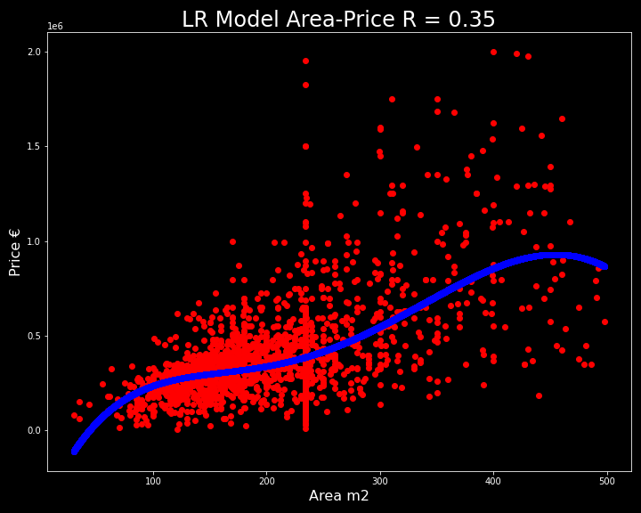
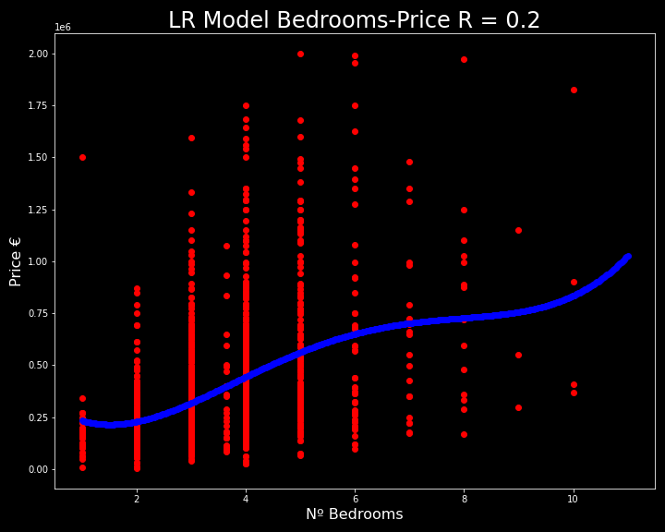
Defining the best regression type
Linear Regression deg = 4 price and area
Linear Regression deg = 4 price and bedrooms

Slide 10
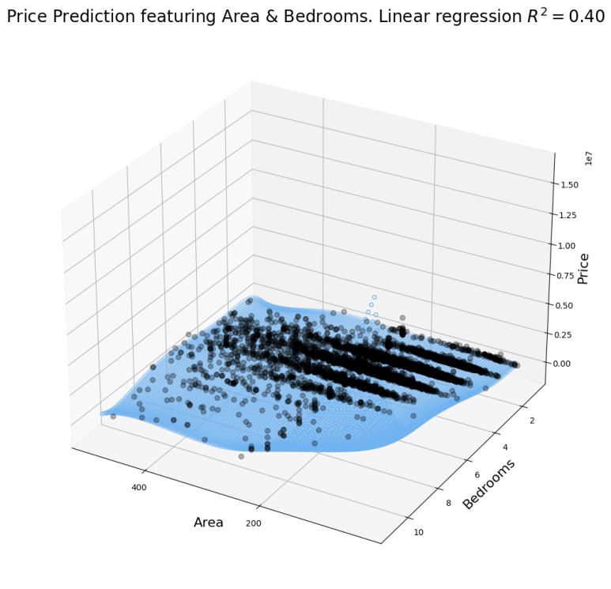
Defining the best regression type
Choosing our features: bedrooms vs area vs state of building;
Linear or polynomial regression?
Evaluating modeling scores;
Notes:
Choosing between linear or polynomial regression: why?
Not all data is regressive: Why?
Evaluating modeling scores: why? What values we got ------→ add a print screen?
Our features: bedrooms and area ----→ discussed in the next slide with ploting

Slide 11
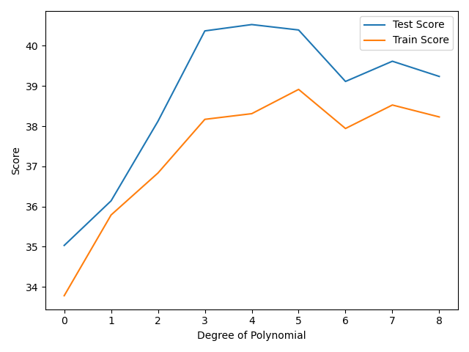
What we could achieve
Model chosen;
Scores from the model;
Features considered.
Not all data is regressive;
Notes:
Model chosen: which?
Scores from the model;
Features considered.
Not all data is regressive;

Slide 12
Recommendations
Further studying different models for machine learning;
Look for other solutions that can include other features;
Bedrooms and area are two features that indeed are useful for price prediction.
Notes:
- Further studying different models for machine learning;
- Look for other solutions that can include other data types: such as for location: logistic regression, etc

Slide 13
Conclusion
What data preprocessing involves;
Not all data is possible to adapt to linear regression
One Hot Encode does not makes sense with linear regression;
Let the data speak = different data types, different approaches! Not all is about model scores
Thank you for your trust and attention.

